Slide 1
INFORMATION RETRIEVAL · WEEKS 6–7
From search system
to measured evidence
1,460
FULL CISI DOCUMENTS
A concise evaluation of Binary Overlap, TF–IDF Cosine, and BM25 on the CISI information-retrieval project.
0.948
BEST DEMO MAP
Sagar Shrestha
Week 8 Project Findings
7/7
TESTS PASSED
01

Slide 2
EXECUTIVE SNAPSHOT
02
What the project established
A working lexical search system was designed in Week 6; Week 7 added controlled model comparison and ranked-retrieval evaluation.
01
Build
02
Compare
03
Evaluate
Parsed CISI-style records, normalized text, built an inverted index, and returned deterministic ranked results.
Held data and preprocessing constant while changing only the scoring model: overlap, TF–IDF, or BM25.
Measured P@k, R@k, MAP, MRR, nDCG@k, latency, and query-level variation with tested formulas.
Decision
Keep TF–IDF as the explainable baseline; validate BM25 on the full CISI collection before selecting a production model.

Slide 3
PROBLEM STATEMENT
03
How can relevant documents be ranked—and trusted?
Natural-language queries rarely match document wording exactly. A useful system must rank partial matches, then prove that the ranking is effective.
USER NEED
“automatic indexing and document retrieval”
The project therefore had two linked problems:
A
Retrieval problem
01
Automatic Indexing Experiments
Transform documents and queries into comparable representations, then produce a ranked top-k list.
02
Abstracting Concepts and Methods
B
Evaluation problem
03
Construction and Use of a Thesaurus
Use relevance judgments and complementary metrics to determine whether early and complete retrieval are good.
The ordering—not just the matches—is the product.

Slide 4
DATASET
04
CISI: a compact, relevance-judged IR collection
1,460
112
3 files
DOCUMENTS
QUERIES
TEST COLLECTION
Library and information-science records
Natural-language information needs
Documents · queries · relevance judgments
Two evidence layers
FULL
Full benchmark target
DEMO
Executed offline demonstration
CISI.ALL, CISI.QRY, and CISI.REL support evaluation over the official 1,460-document collection. The code includes download, parsing, and validation.
18 concise records, 8 queries, and manual binary judgments prove the pipeline in a restricted environment. These scores are illustrative—not benchmark claims.
Interpretation rule → never generalize demonstration scores to the full CISI collection.
Source: University of Glasgow IR Test Collections · ir.dcs.gla.ac.uk/resources/test_collections/cisi/

Slide 5
METHODOLOGY
05
One pipeline, three scoring models
01
02
03
04
05
06
Parse
Normalize
Filter
Index
Score
Rank
.I / .T / .A / .W
lowercase · tokenize
stop words · stemming
term → doc / tf
model-specific
top-k results
Controlled comparison
Same data
Same representation
Same cut-offs
Only score changes
Documents, queries, judgments
Title boost and preprocessing
k = 1, 3, 5, 10
Fair model comparison
Design principle: hold everything constant except the retrieval function.

Slide 6
RETRIEVAL MODELS
06
Three increasingly expressive lexical baselines
TERM PRESENCE
WEIGHTED VECTOR
PROBABILISTIC
Binary overlap
TF–IDF cosine
BM25
Coverage of unique query terms
log TF × smooth IDF × cosine
IDF + TF saturation + length
STRENGTH
STRENGTH
STRENGTH
Fast and transparent
Best demonstration MAP
Strong classic baseline
TRADE-OFF
TRADE-OFF
TRADE-OFF
No rarity or length signal
Lexical mismatch remains
Parameters need validation
The score scales differ; compare rankings and metrics—not raw scores.
Methods: Manning, Raghavan & Schütze (2008); Robertson & Zaragoza (2009)

Slide 7
EVALUATION
07
Complementary metrics answer different questions
P@k
How pure is the top-k list?
R@k
How much relevant material was found?
MAP
Are all relevant items ranked early?
MRR
How soon is the first useful result?
nDCG@k
Is relevance concentrated near the top?
Evaluation protocol
8 judged queries
Full ranking for MAP / MRR
k = 1, 3, 5, 10
500 timing repetitions
Effectiveness is the primary outcome. Sub-millisecond latency is descriptive only.
Evaluation definitions: Introduction to Information Retrieval, Chapter 8 · nDCG: Järvelin & Kekäläinen (2002)

Slide 8
EVALUATION RESULTS
08
Ranking quality differs even when recall is identical
0.325
1.000
Same coverage, different ordering
MAP, MRR, and nDCG reveal differences hidden by P@5 and R@5.
P@5 · ALL MODELS
R@5 · ALL MODELS
MAP
MRR
nDCG@5
Binary overlap
0.937
1.000
0.970
MAP
MRR
nDCG@5
TF-IDF cosine
0.948
0.938
0.962
MAP
MRR
nDCG@5
BM25
0.927
0.938
0.952
Winner depends on the question
TF–IDF leads MAP · Binary overlap leads MRR and nDCG@5 · BM25 remains competitive

Slide 9
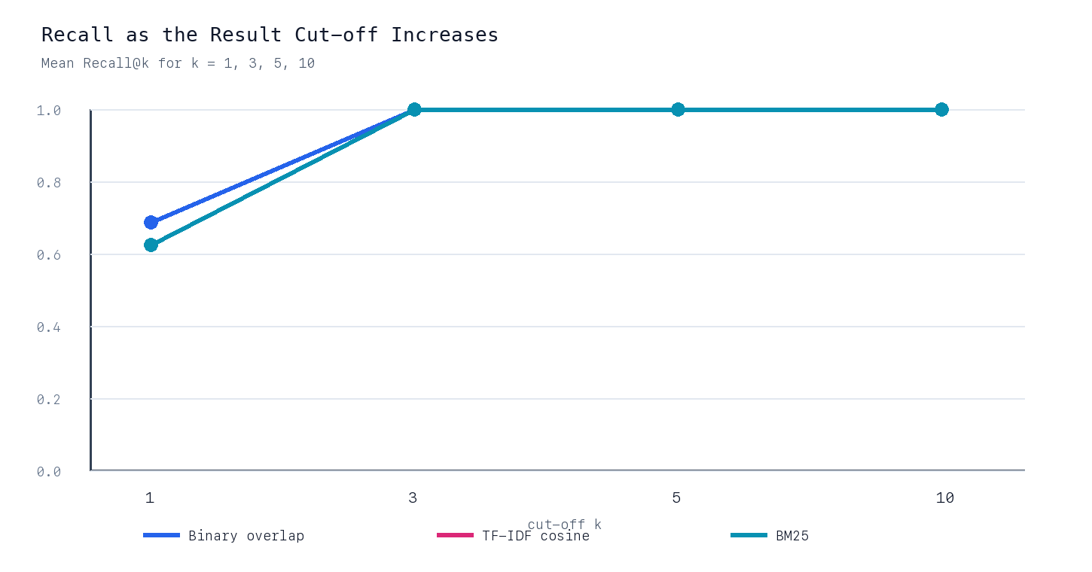
MAJOR FINDINGS
09
What changed across models and cut-offs
01
TF–IDF: best complete ranking
MAP = 0.948. It ranked both relevant items ideally for Q3 and Q4.
02
Overlap: best first answer
MRR = 1.000 and P@1 = 1.000, aided by simple term coverage and deterministic ties.
03
Differences are concentrated
Five of eight queries tie at AP = 1.000. Q3, Q4, and Q8 drive the model ordering.
Recall reaches 1.000 by rank 3 for every model; larger k adds non-relevant items and lowers precision.
Do not read a 0.010 MAP difference as decisive: eight queries are too few for a stable winner.

Slide 10
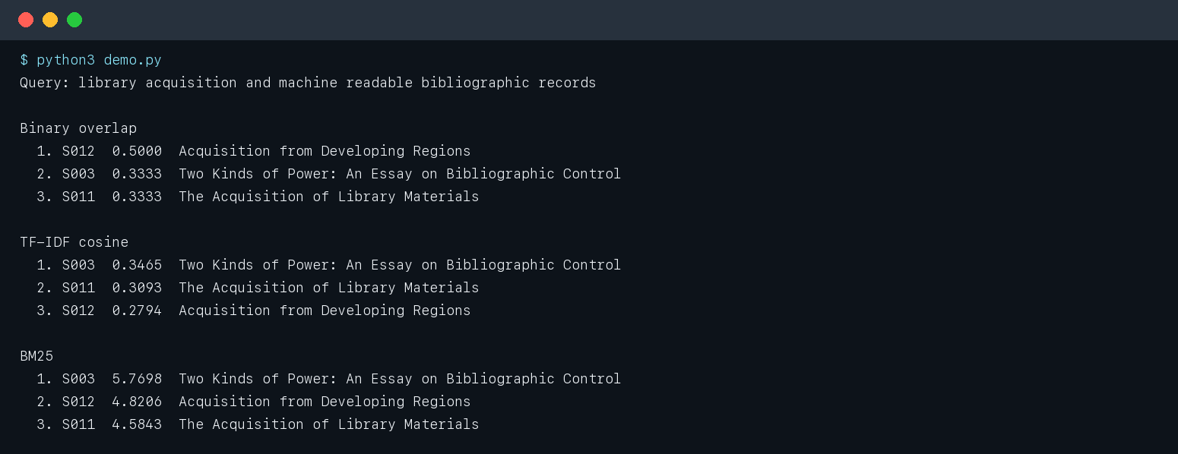
SAMPLE OUTPUT
10
One query exposes three ranking behaviors
Q8 insight
Overlap ranks relevant S012 first; TF–IDF and BM25 rank non-relevant S003 first because several weighted terms match.

Slide 11
CRITICAL ANALYSIS
11
Strong implementation evidence; limited model-selection evidence
What is strong
What limits the claim
● Identical controls across models
● Transparent, dependency-free scoring
● Known-answer metric tests pass
● Aggregate and per-query evidence
● Reproducible JSON, code, and figures
● Only 18 documents and 8 queries
● Manual—not official—judgments
● Tie order benefits the overlap model
● BM25 parameters were not tuned
● Latency is too small to generalize
Claim boundary → the evaluation proves the pipeline, not the best model for full CISI.

Slide 12
RECOMMENDATIONS
12
Move from demonstration to defensible model selection
1
Run full CISI
2
Tune fairly
Evaluate all 1,460 documents and official judgments.
Use development queries for BM25 k1/b; keep test queries untouched.
3
Quantify uncertainty
4
Address vocabulary gaps
Report paired query differences and confidence intervals.
Compare stronger stemming and controlled query expansion.
Recommended baseline
It delivered the best demonstration MAP, remains explainable, and requires no fitted parameters. Reconsider only after full-collection evidence.
Retain TF–IDF now.
Build → compare → measure → challenge the evidence → iterate
Project repositories prepared: github.com/Chief-spartan-117/week-6-ir-system · /week-7-ir-evaluation

